Slide 1

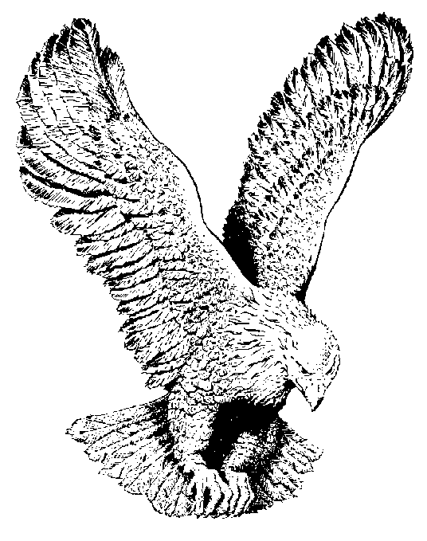
857 O LITTLE TOWN OF BETHLEHEM
O little town of Bethlehem,
How still we see thee lie!
Above thy deep and dreamless sleep
The silent stars go by;
Yet in thy dark streets shineth
The everlasting Light;
The hopes and fears of all the years
Are met in thee to-night!

Slide 2
For Christ is born of Mary;
And gathered all above,
While mortals sleep, the angels keep
Their watch of wondering love.
O morning stars, together
Proclaim the holy birth,
And praises sing to God the King,
And peace to men on earth!

Slide 3
How silently, how silently,
The wondrous gift is given!
So God imparts to human hearts
The blessings of His heaven.
No ear may hear His coming;
But in this world of sin,
Where meek souls will receive Him still
The dear Christ enters in

Slide 4
O holy Child of Bethlehem,
Descend to us, we pray;
Cast out our sin and enter in—
Be born in us to-day!
We hear the holy angels
The great glad tidings tell,—
Oh, come to us, abide with us,
Our Lord Emmanuel!

